Slide 1
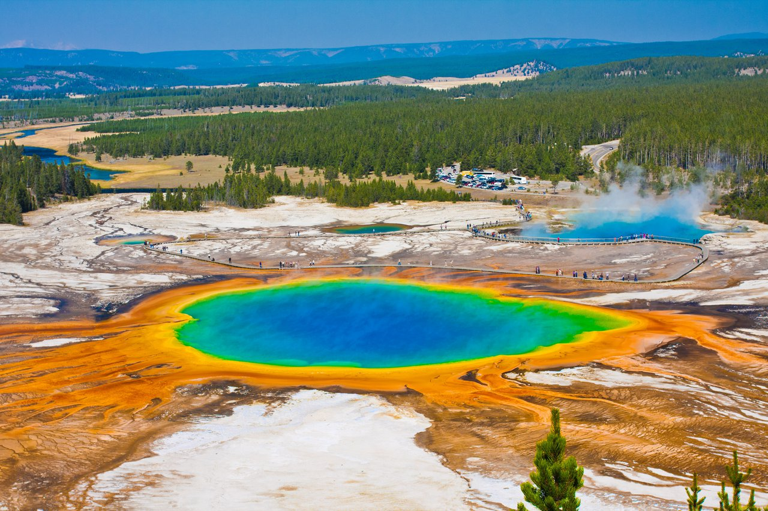
YellowStone National Park Recreation Visits prediction
Team Members:
Ambar Singh
Giridhar Reddy Vengalam
Harshit Rai

Slide 2
Data Set
Data Includes:
Number of Recreational Visits to Yellow Stone National Park.
Temperature data such as lowest, highest, maximum coldest , minimum warmest, mean, average minimum and maximum temperatures.
Precipitation data such as maximum precipitation of 24hr and total precipitation of the month.
Snowfall data such as maximum snowfall of 24hr and total snowfall of the month.
Data about change in three months in airfare, jet fuel cost, food cost and gasoline prices.
Data about unemployment rate.
Customer sentiment index as well as price index.

Slide 3
Benefits From Analysis
Predicting the number of visitors to the Yellow Stone National Park would help improve below factors:
Employee staffing and their deployment in an efficient manner.
Better utilization of resources and infrastructures.
Optimization of financial allocations and ways to increase profit margins.
Check for possibilities of improvements in winter tourism in off season based on accessibility.
Estimation of public facilities requirements and number as well as capacity of campsites.

Slide 4
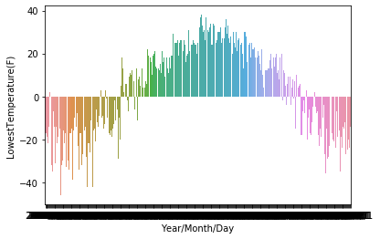
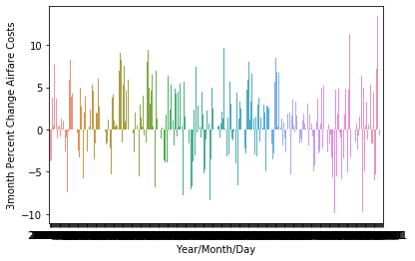
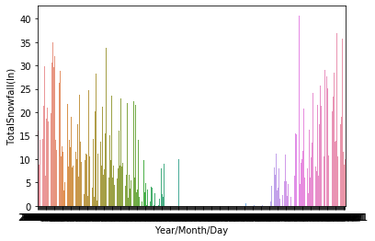
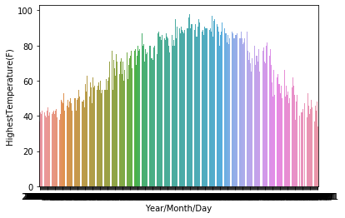
Data Preprocessing
Data was extracted in monthly and yearly format from date time format originally given in dataset.
NA values were replaced using imputing values in order to maintain the trend correctly. They were replaced by mean values of the respective months.
New features were created such as accessibility to the park.
Seasonality was introduced as the dataset was divided into two parts based on volume of visitors and the months when park is fully opened to visitors i.e May to October.

Slide 5
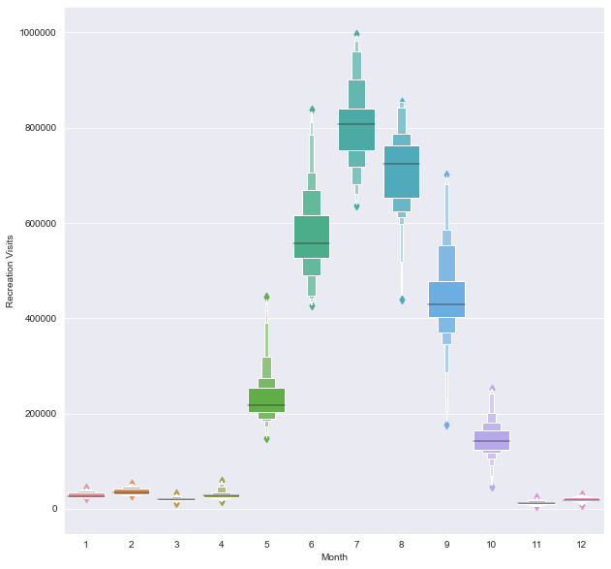
Exploratory Data Analysis
Monthly volume of recreational visits.
Shows that there is a high volume of visitors from May to October month.
Website says 90% services are shutdown from November to April.

Slide 6
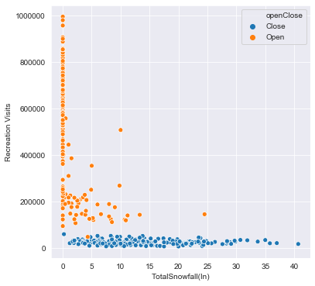
Exploratory Data Analysis
Dormant zone is due to Park Services shutdown.
Visitor volume is high during those days where it did not snow at all or snowed negligibly.
Considered Linear distribution only for Moderate to Highly active data zone.

Slide 7
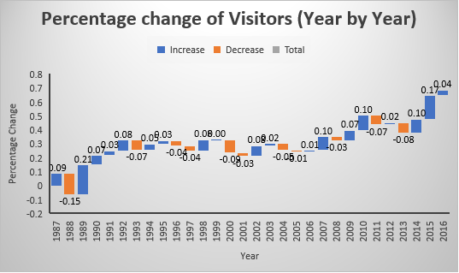
Major Findings
Seasonality is found in data as considerable visitor volumes is found in months from May to October and is highest in July. This dormancy in number of visitors during the winter is due to the shutdown of 90% of services in the park from November to April.
It was found that airfare costs, food away from home costs, gasoline costs, jet fuel costs, consumer price index, consumer sentiment index and unemployment rate do not significantly contribute towards the visitor volumes while climatic conditions are the ones that hugely impact the visitor volumes.
There has been an increasing trend in the year on year visitor volume averaging approximately 2% for last 30 years whereas in last 5 years it has been approximately 5%.

Slide 8
Regression Model
Considering the seasonality, the scope of our multi-linear model to predict visitor count is restricted to the open season (May-October).
We developed a model using features such as Mean Temperature, Average Minimum Temperature, Highest Temperature and Maximum 24h precipitation.
Approximately 79% of variation in number of visitors is explained by features used in our model.
The model satisfies all the assumptions of multi-linear model and the cross-validation result justifies the optimal fitting of the model.

Slide 9
Recommendations
Staffing for the national park could be done on seasonal basis i.e May to October.
Part time staffers could be employed during the months where predicted visitor volumes are high such as July and August.
Since the number of visitors is not significantly dependent on the food and lodging cost in and around the YSNP (as per our prediction model) thus, we can increase such costs marginally to extract a better profit margins.
Public facilities can be planned and arranged in advance as per the expected number of visitors from the prediction model.
The number of campsites and the visitors it can accommodate can be increased or decreased as per the predicted number of visitors.
Since, the number of visitors is low during six months of snow, the entry fee should be reduced or waived off and discounted packages can be offered in order to increase winter tourism.

Slide 10
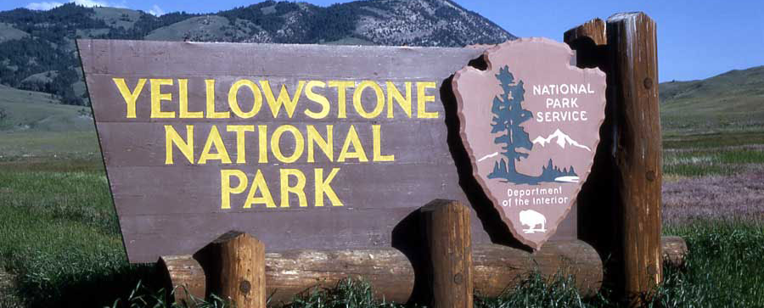
THANK YOU !
Keep warm through the winters !

